Slide 1

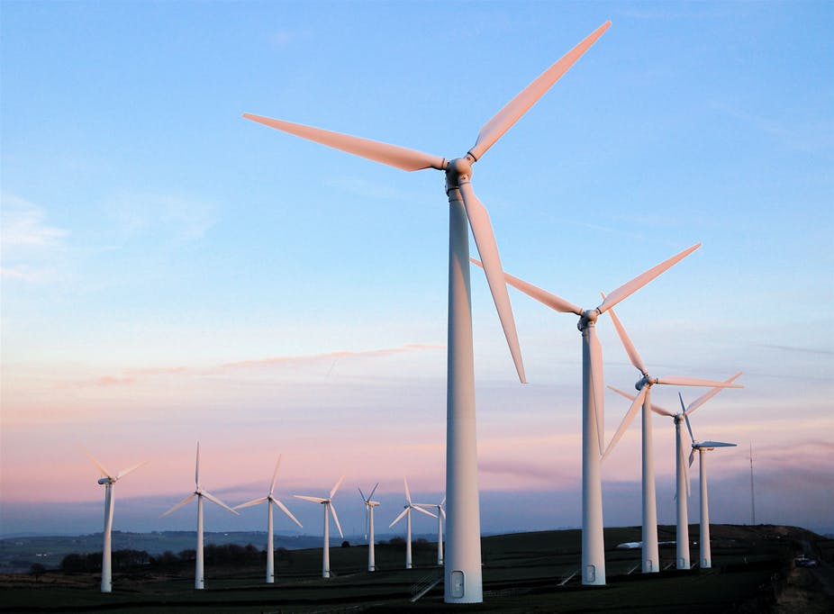
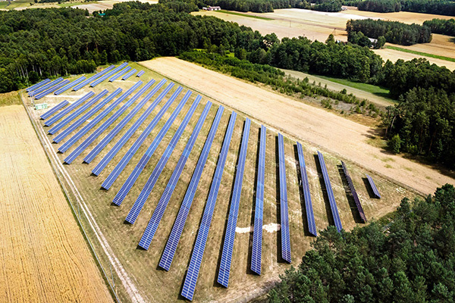
Renewable energy auction systems in the V4 countries
13 April 2022
Christian Schnell PhD, senior expert, legal advisor, partner at Dentons

Slide 2
Legal basis: Energy and Environment Aid Guidelines (EEAG)
EEAG must be followed in case of granting state aid
All EU member states are obliged to grant operative support in a competitive bidding process, obligation is applicable from 2017 for all new investments with at least 1 MW installed capacity
Aid shall be granted as a premium in addition to the market price (fixed premium or contract for difference with a pay-back obligation in case of market prices exceeding the bid price)
RES installations shall sell its electricity directly in the market and take balancing Risk
The bidding process can be limited to specific technologies where a process open to all RES installations would lead to a suboptimal result, for example the need to achieve technical diversification or network constraints/grid stability
Support systems already notified prior to 2017 can be continued

Slide 3
V4: Recent experience with auction support systems
Only Poland and Hungary have for the time being implemented RES auction systems, Poland experienced 7 auction rounds and Hungary 5 auction rounds
The praxis has shown that auction systems are well designed for intermittent RES installations which compete with success in the same auction basket
In case administrative hurdles, e.g. planning law restrictions or grid connection constraints block one of the technologies only projects using the same technology compete between each other
With fuel based RES technologies, e.g. biomass and biogas plants but also small hydropower plants recent experience has shown that a competitive bidding system is not effective due to lack of installations being eligible for auction and therefore competition is missing
Consequently, changes of the support system to a feed-in tariff below 500 kW and feed-in premium without bidding process until 1 MW capacity have been introduced
Offshore wind requires an extra auction system and for developed projects individual notification of state aid

Slide 4
The German „Easter Package” - until 2035 to Net-Zero power generation
RES general target 2030
Increase from currently 42% to min. 80% of gross power generation
Onshore Wind
56 GW
New 2030 target
of 115 GW
Solar PV 59 GW
New 2030 target
of 215 GW
New development equally split between rooftop and ground-mounted solar PV
Offshore Wind
7 GW
New targets:
2030 – 30 GW,
2035 – 40 GW,
2045 – 70 GW
Operative support for energy cooperatives & clusters granted without tenders for up to 6 MW solar PV and 18 MW onshore wind
No further decrease of ceiling prices for the next two years
HIgher ceiling prices for low wind areas
Innovative auctions (PV + battery storage) receive contract-for-difference support
New auctions for RES + hydrogen production
No limitations in size of pilot projects
Higher incentives for solar PV combined with agricultural use and floating PV
Pre-investigated sea areas receive contract-for-difference support
New non-investigated sea areas receive support based on qualitative criteria
Rooftop feed-in tariff wil be increased, rooftop own-consumption faces decrease of incentives
Source: BMWi, Dentons

Slide 5




The future: sector coupling.
Direct electrification
Heat pumps
e-mobility
Electrolysis
Hydrogen
Ammonia
Methanisation
Hydrogen
Wood biomass
Agricultural biomass

